Slide 1

Email Classification as Abusive or Non-Abusive
An NLP based project where we are required to predict the incoming email if it is Abusive or Non-Abusive based on the data provided.

Slide 2
Business Objective
Inappropriate emails would demotivates and spoil the positive environment that would lead to more attrition rate and low productivity and Inappropriate emails could be on form of bullying, racism, sexual favoritism and hate in the gender or culture, in today’s world so dominated by email no organization is immune to these hate emails.
The goal of the project is to identify such emails in the given day based on the above inappropriate content

Slide 3
Group Members
Sr. No. | Member Name | Email Contact
1 | Ms. Rutuja Rajendra Mhamunkar | rutujamhamunkar@gmail.com
2 | Mr Yashvardhan Hemantrao Patil | patilyashvardhan551@gmail.com
3 | Miss Priyanka Chinchanasoor | priyankabcc1999@gmail.com
4 | Renuka B Madari | renukapatil7019@gmail.com
5 | M.r Rakesh R Gomadi | rakeshgomadi@gmail.com
6 | Ritik Sunil Parate | ritikparate1@gmail.com
7 | Ms. Sejal Sudhir Hadke | sejalhadke493@gmail.com

Slide 4
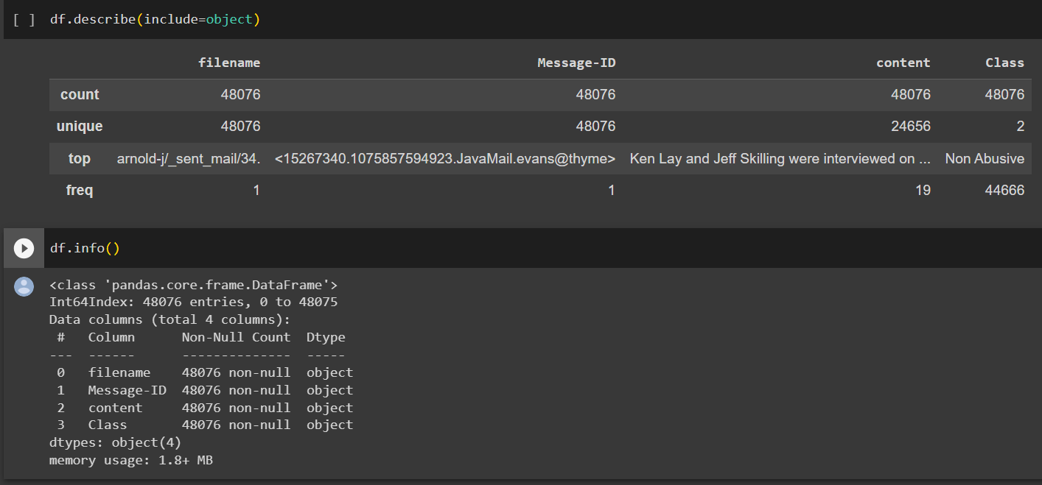
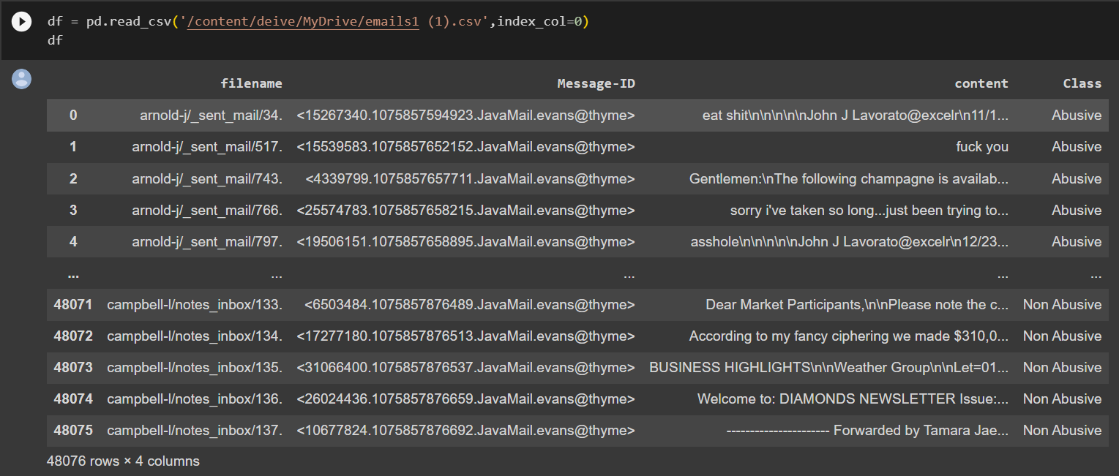
Provided Dataset Details.
We got a text file with thousands of emails sent by company employees to each other which contained all abusive and non-abusive mails.
First we had to convert that text file to csv or excel file for Analysis and Model Building.

Slide 5
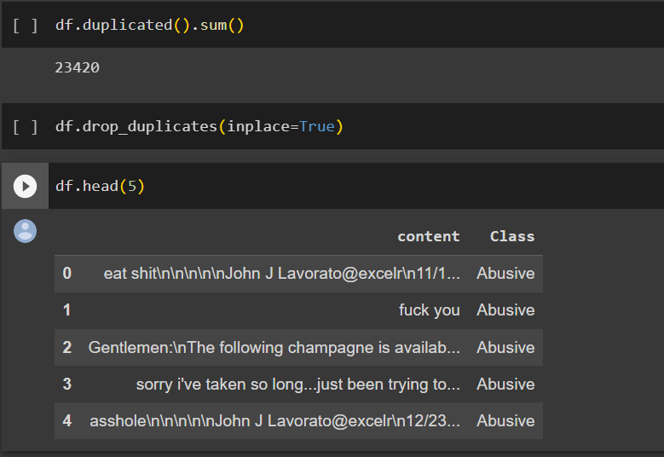
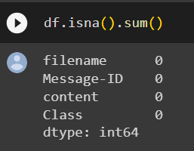
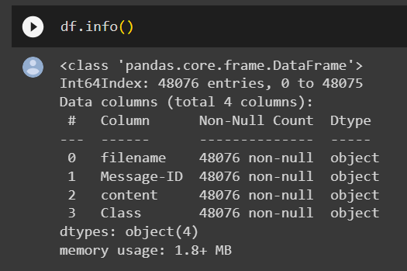
Exploratory Data Analysis(EDA)
Checking for null values.
There are no null values
in the Dataset.
There are 23420 duplicated values which we have dropped
for accurate analysis
Checking description of Dataset using
info function

Slide 6
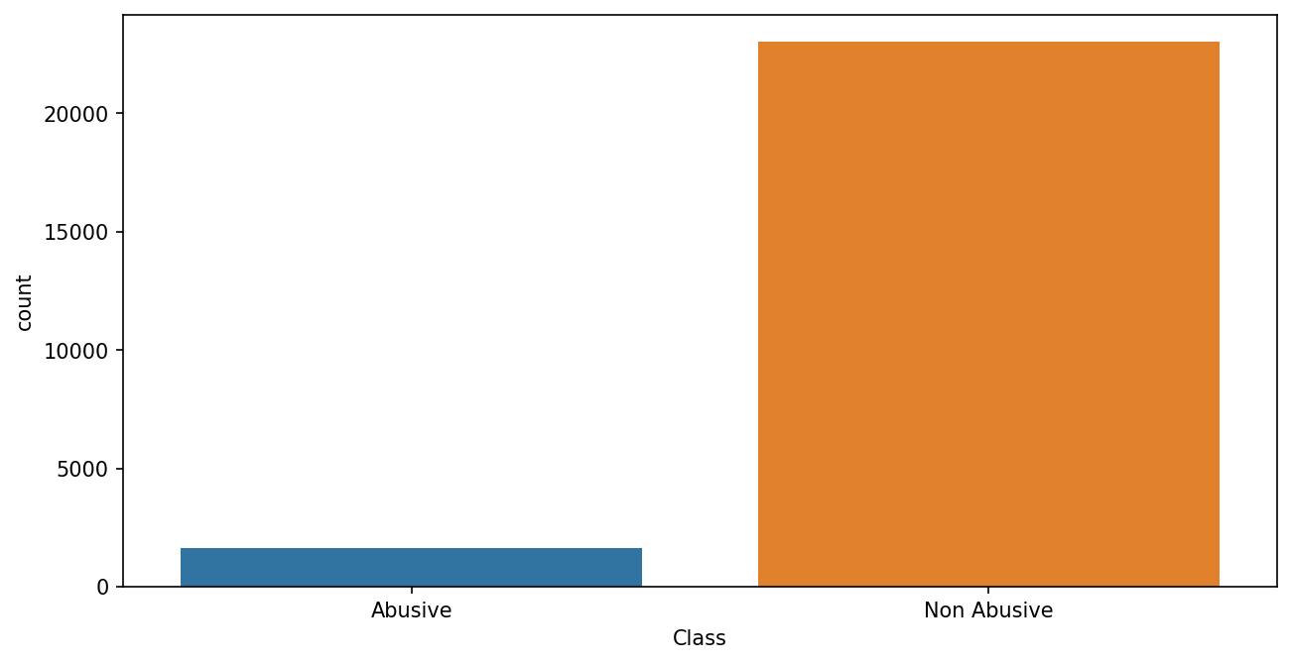
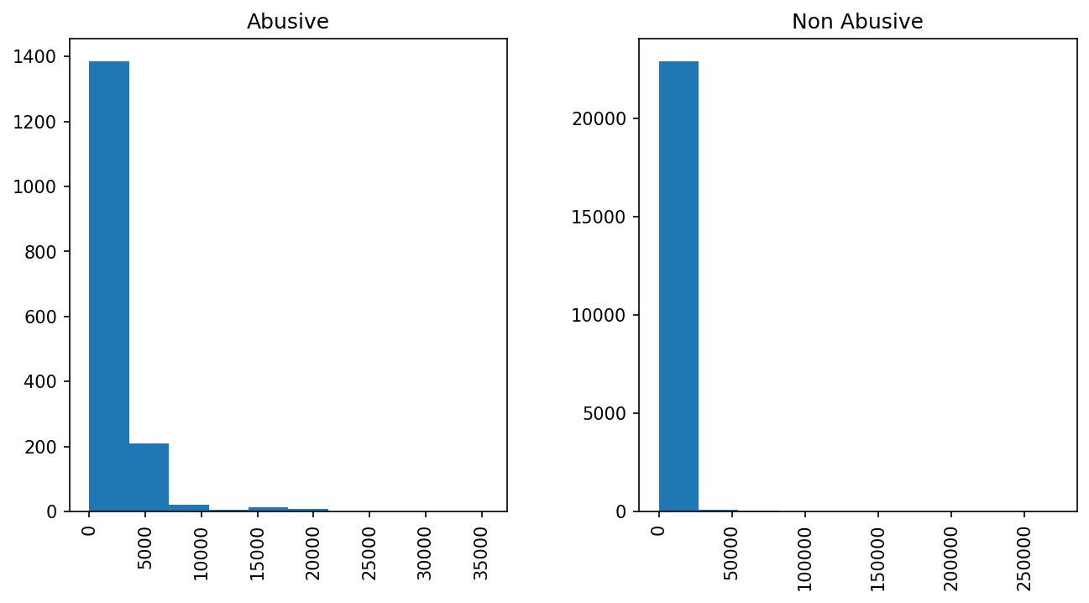
Count plot of abusive and non-abusive emails .
Histogram of Abusive and non-abusive mails based on the
length of the mail content

Slide 7
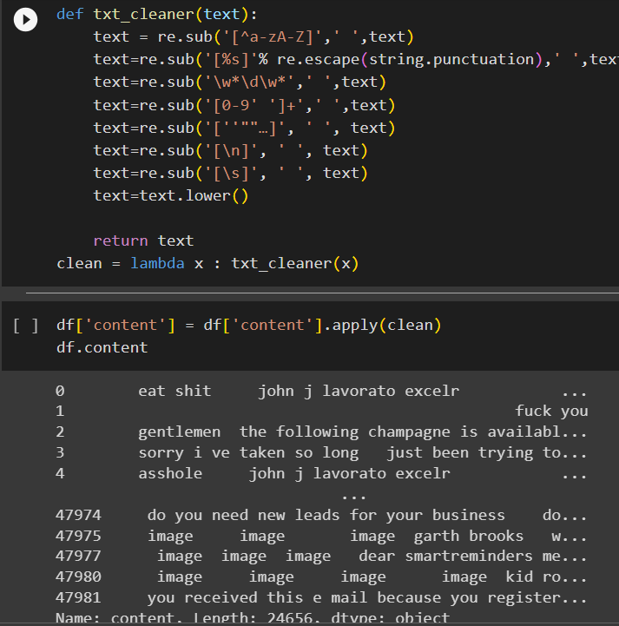
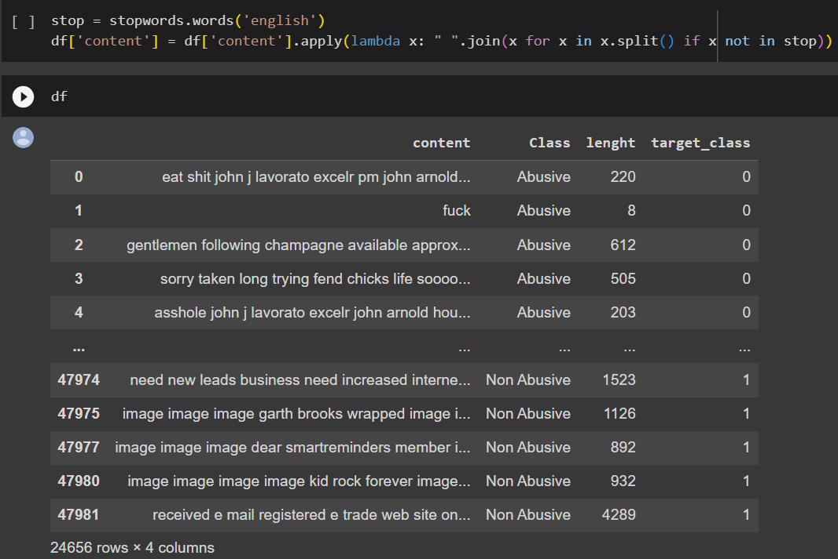
Text Cleaning
Removing stopwords from the mail content.
Removing all the special characters, punctuations, and numbers.

Slide 8
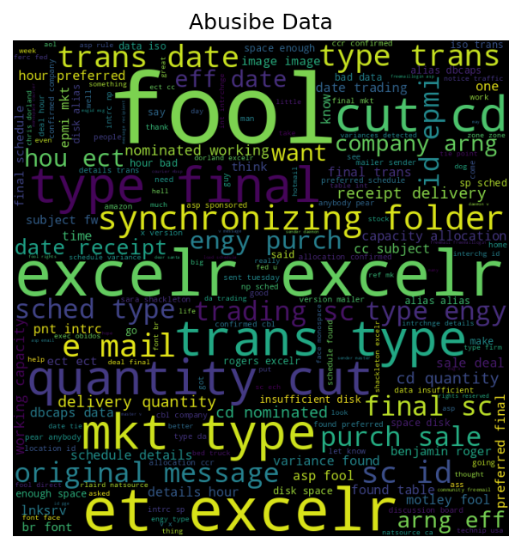
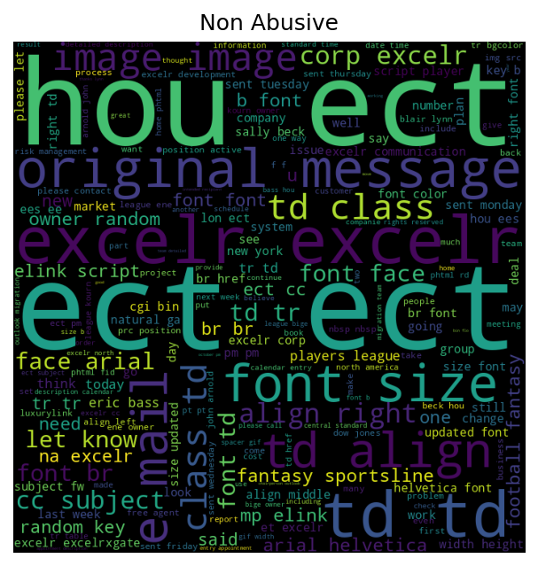
Word Cloud
Abusive Data

Slide 9
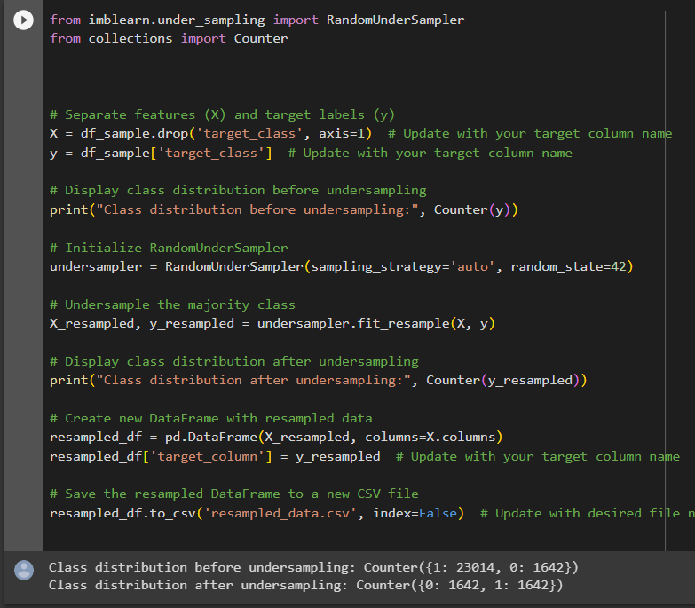
Resampling Data
From the countplot we understood that our data is highly imbalanced. Therefore we have to Resample our Dataset to solve the data imbalance problem.

Slide 10
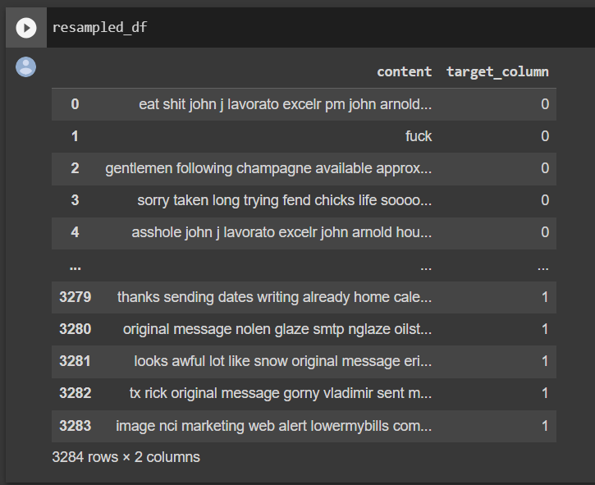
Resampled Dataset

Slide 11
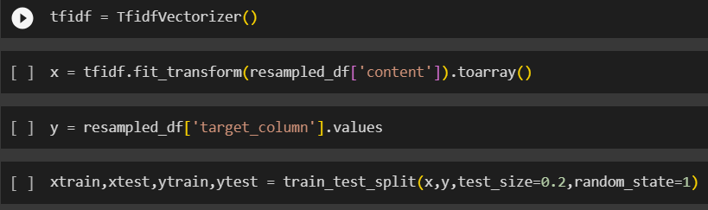
Model Building
Model Building in an NLP project is an complicated task where we have to keep the data as clean and to its simplest form.
For text predictions we have to keep data in its simplest form.
It is required to remove punctuations, special characters, and numbers. Also it is required to remove stop words from the Data(like: The, is, in, etc).
Finally we also have to lemmatize the text data for conversion into simplified form.
This completes the process of Text Pre-processing. After which the Data is set for Model Building.
Setting up dataset on top of TF-IDF Vectorizer and splitting the train and test Data.

Slide 12
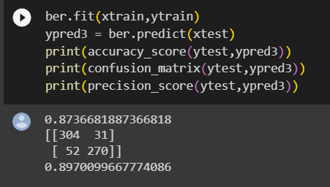
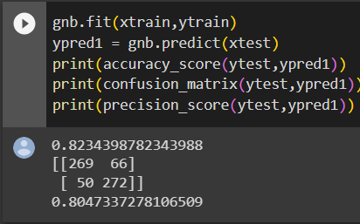
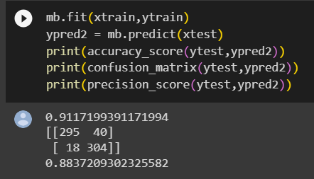
Models Selected
On the basis of our Research and Analysis we have finalized few Classifier Models to work on.
First we tried most famous Naïve Bayes Classifier with all its subtypes, Bernoulli, Multinominal, and Gaussian Naïve Bayes Classifier.
Bernoulli Naïve Bayes Classifier
Gaussian Naïve Bayes Classifier
Multinominal Naïve Bayes Classifier

Slide 13
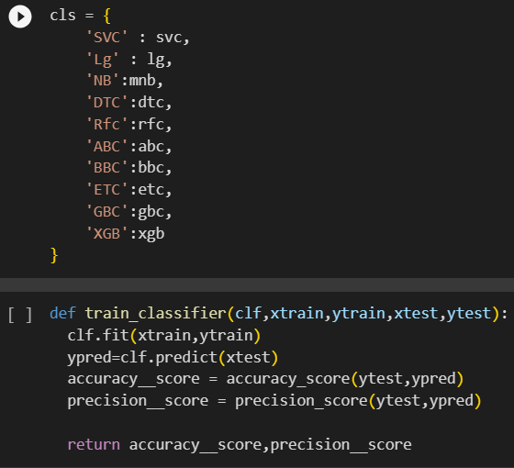
Models Selected
Then we tried on many different Classification Models including
Support vector Classifier
Regression Classifier
Decision Tree
Random Forest
AdaBoost Classifier
Gradient Boosting Classifier, etc

Slide 14
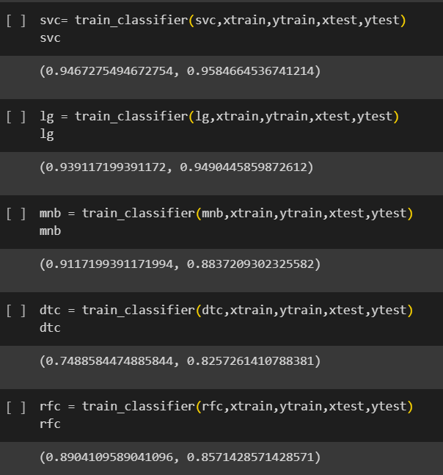
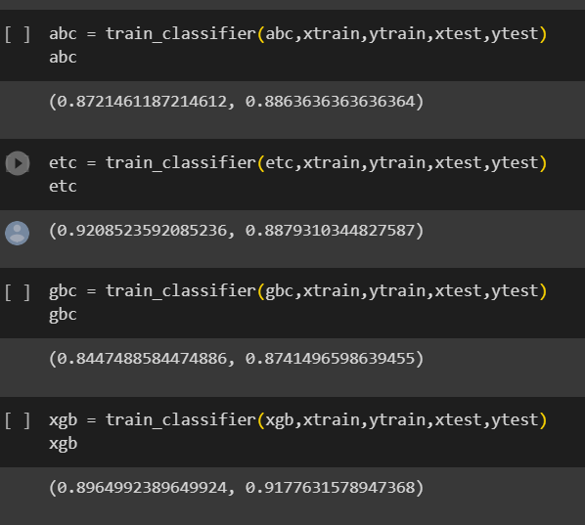
Accuracy and Precision outputs for each Classifier Model.
(Accuracy, Precision)

Slide 15
Conclusion on the Classifier Models Built.
Based on our Project Agenda of email classification, we are required to get better True Positive(TP) rate.
Therefore, we will look for Precision value for the evaluation of each Model. Accuracy is less important in this case. We will more focus on the Precision instead of Accuracy.
So, we are getting best Precision for SVC Classifier also the Accuracy is good enough.
Accuracy = 94.6 and Precision = 95.8
But still there is a scope of improvement, We can use Voting Classifier to improve Precision and Accuracy value.
In Voting Classifier we combine the best performing 2-3 Models to get the best out of every model and attain Precision with best Accuracy.

Slide 16
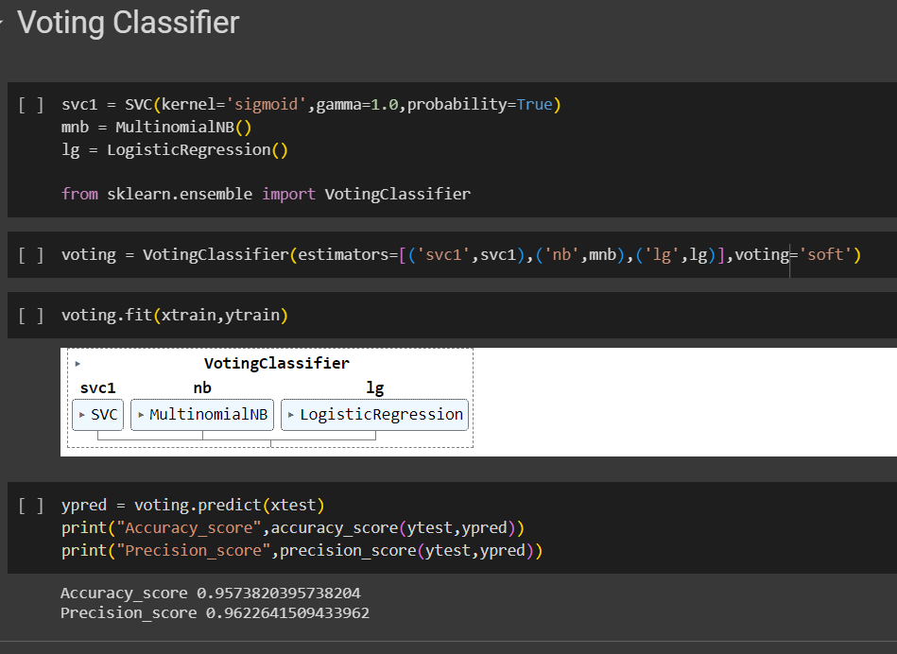

Slide 17
Conclusion on Voting Classifier
Voting Classifier built on top of Support Vector Classifier, Multinominal Naïve Bayes, and Logistic Regression gives the best output on Precision and Accuracy.
Accuracy = 95.73, Precision = 96.22
Therefore, we have finalized the Voting Classifier as the best Model for email Classification.
We also exported the SVC Model as it is the second best performing Model.

Slide 18
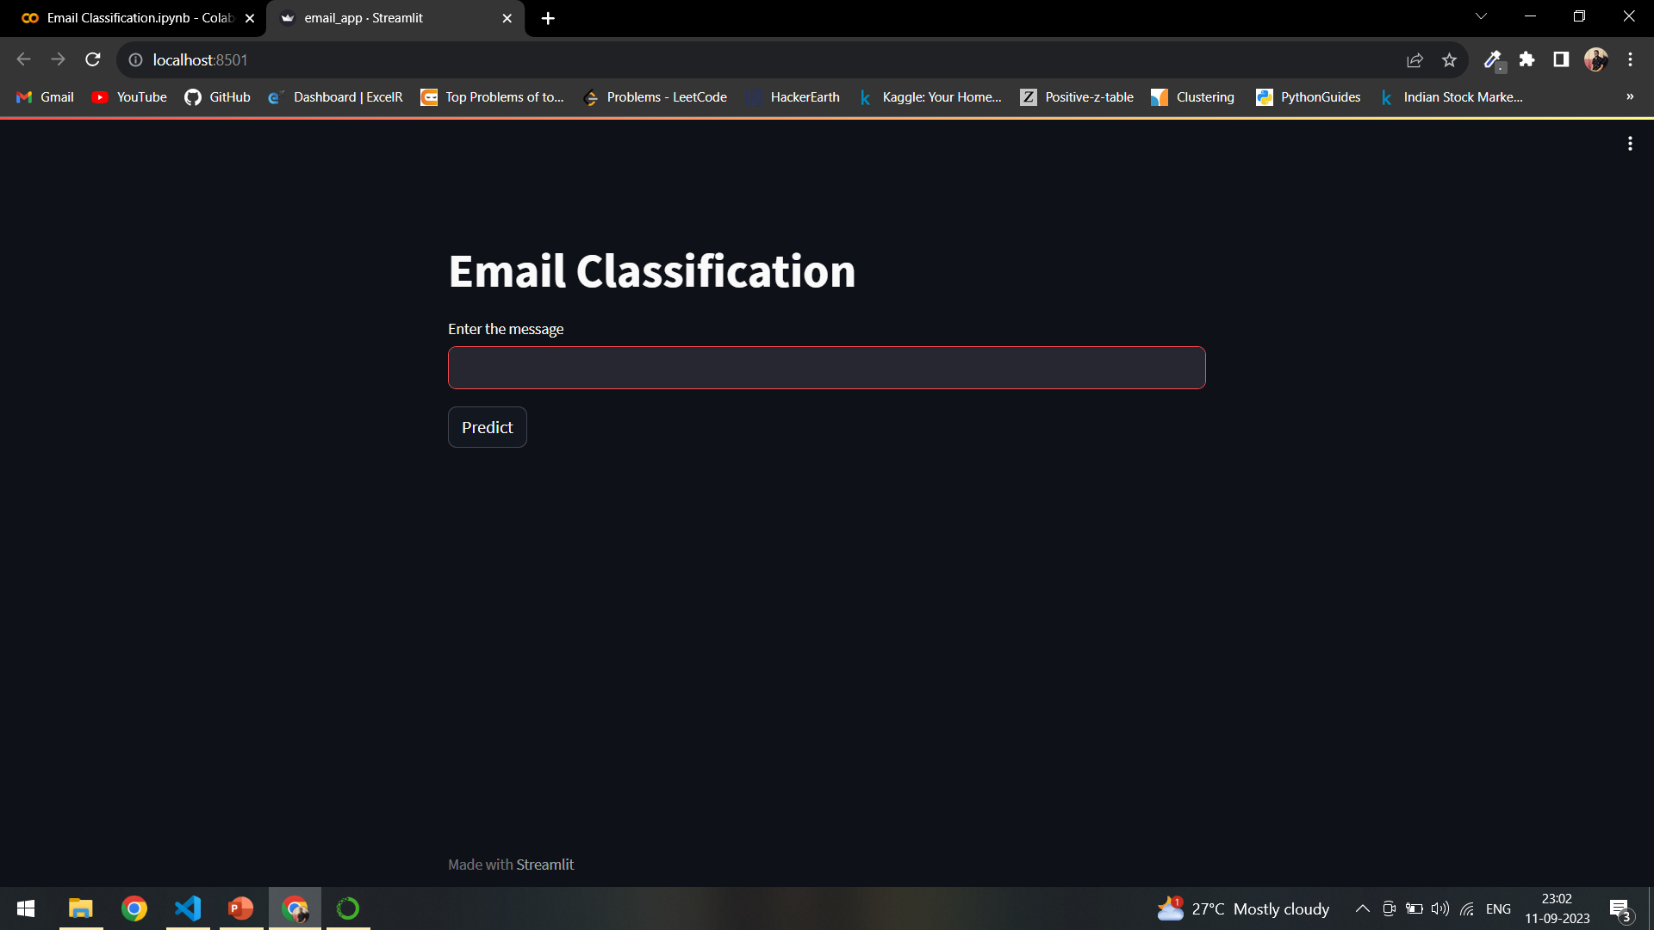
Deployment

Slide 19
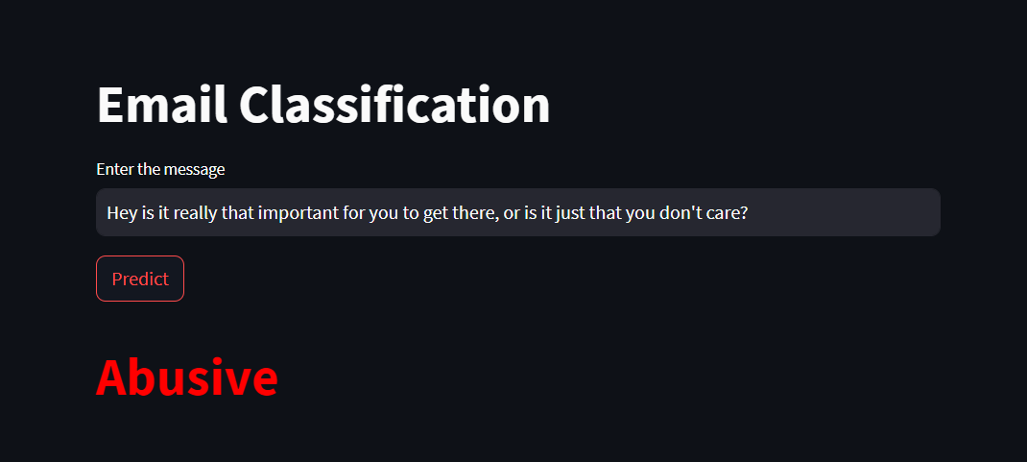
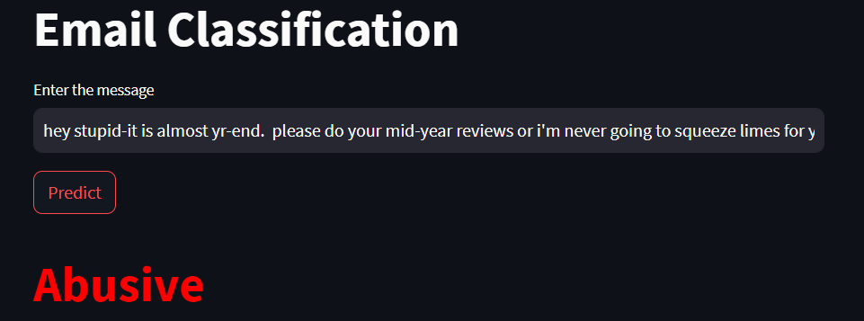
Abusive email prediction examples.

Slide 20
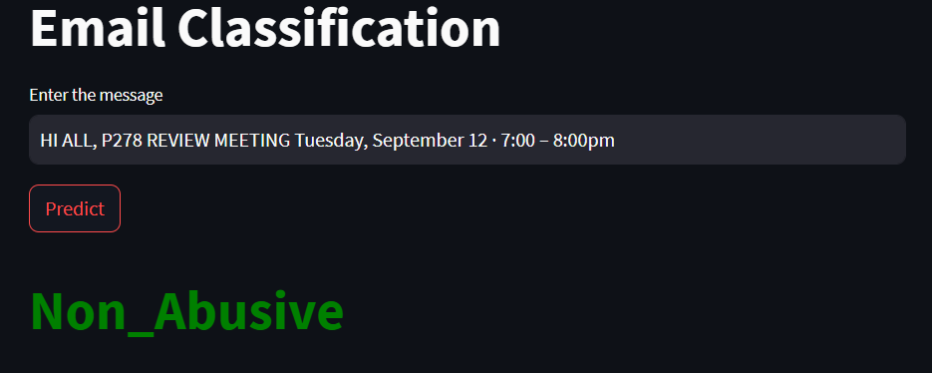
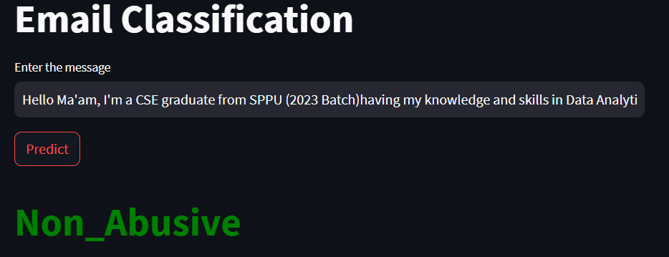
Non-Abusive email prediction example

Slide 21
THANK YOU.
Any Questions?

